Slide 1
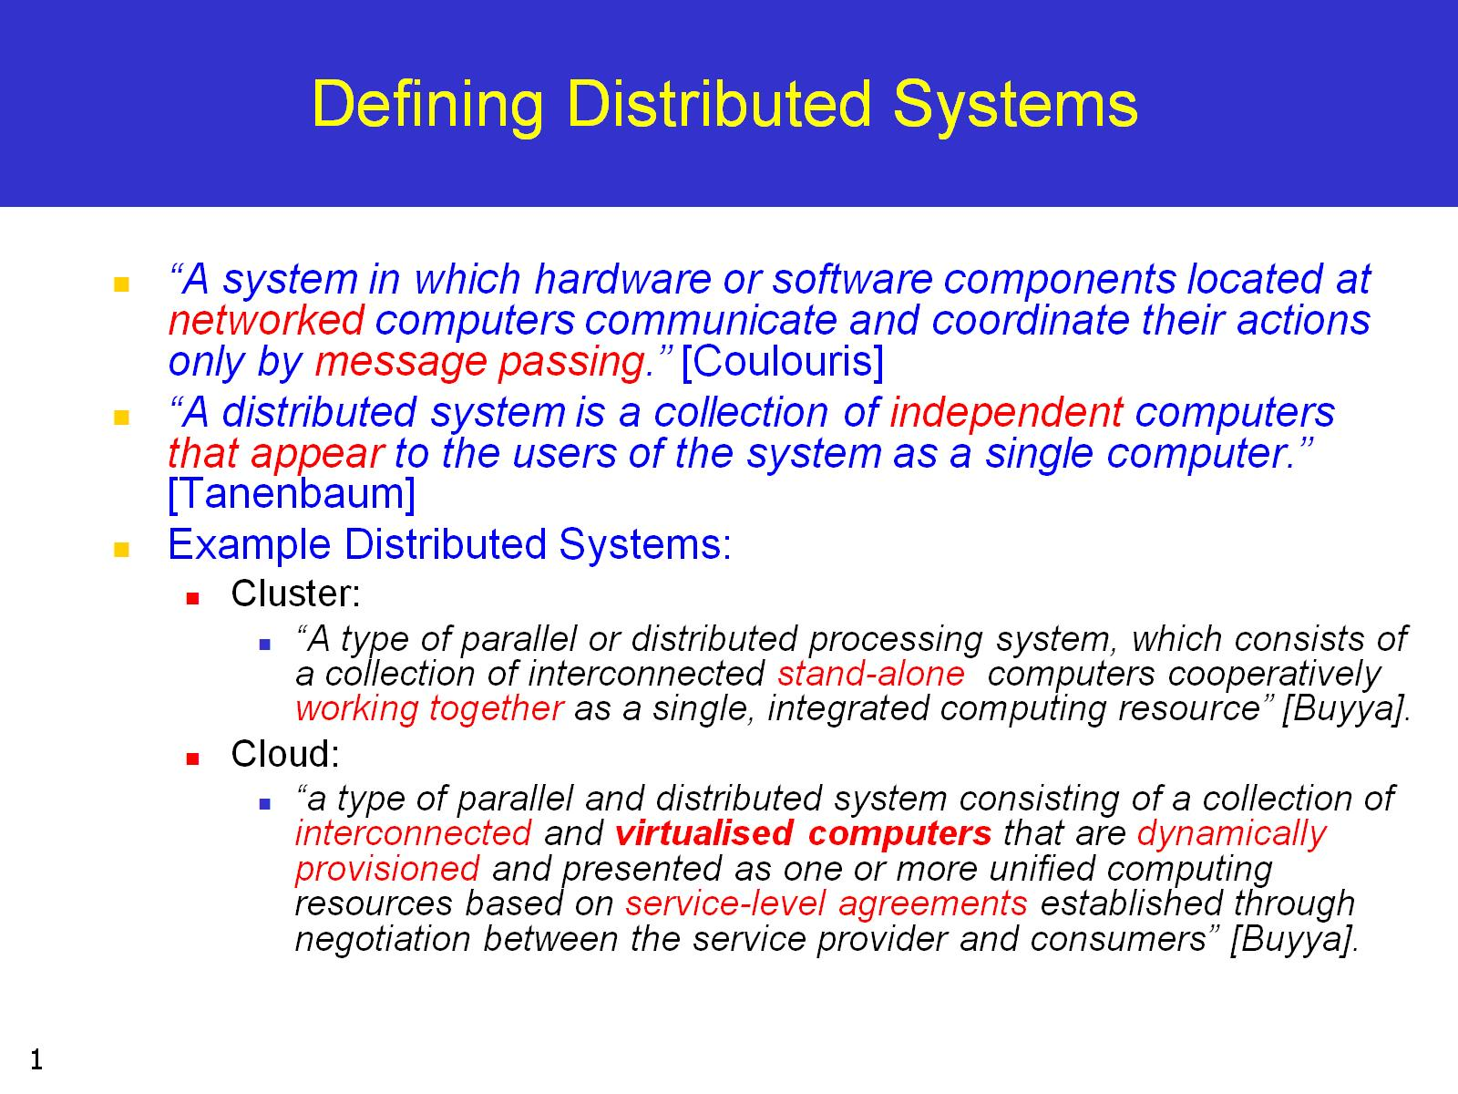
Defining Distributed Systems

Slide 2
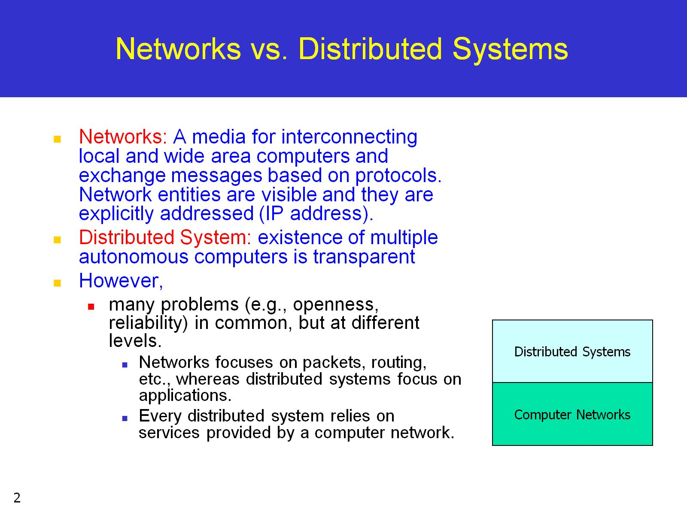
Networks vs. Distributed Systems

Slide 3
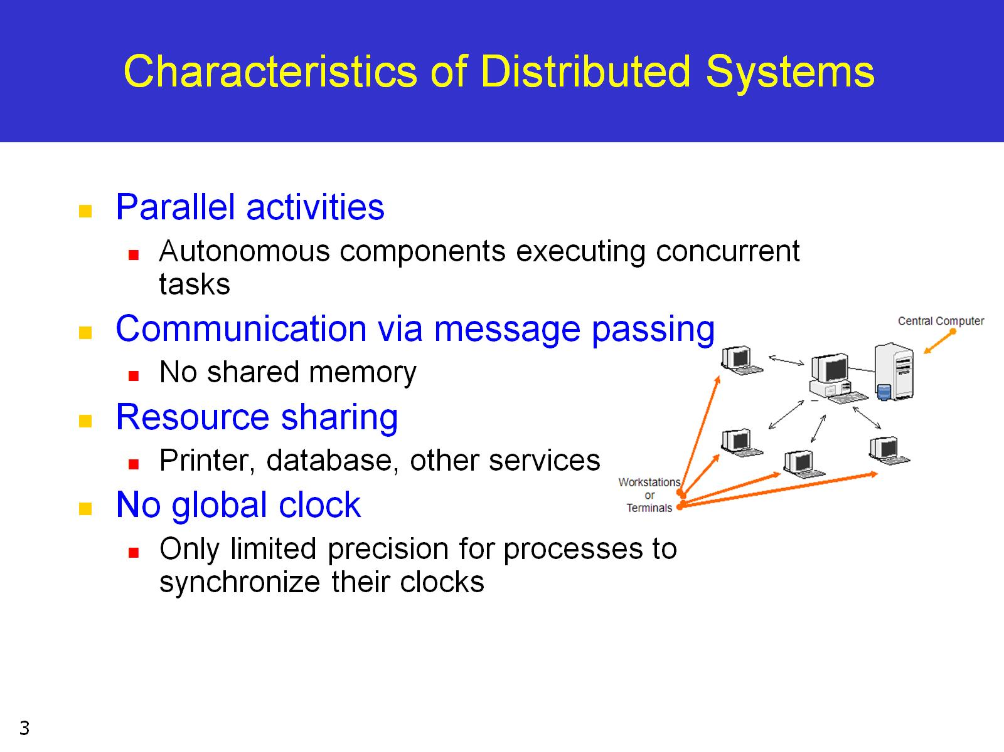
Characteristics of Distributed Systems

Slide 4
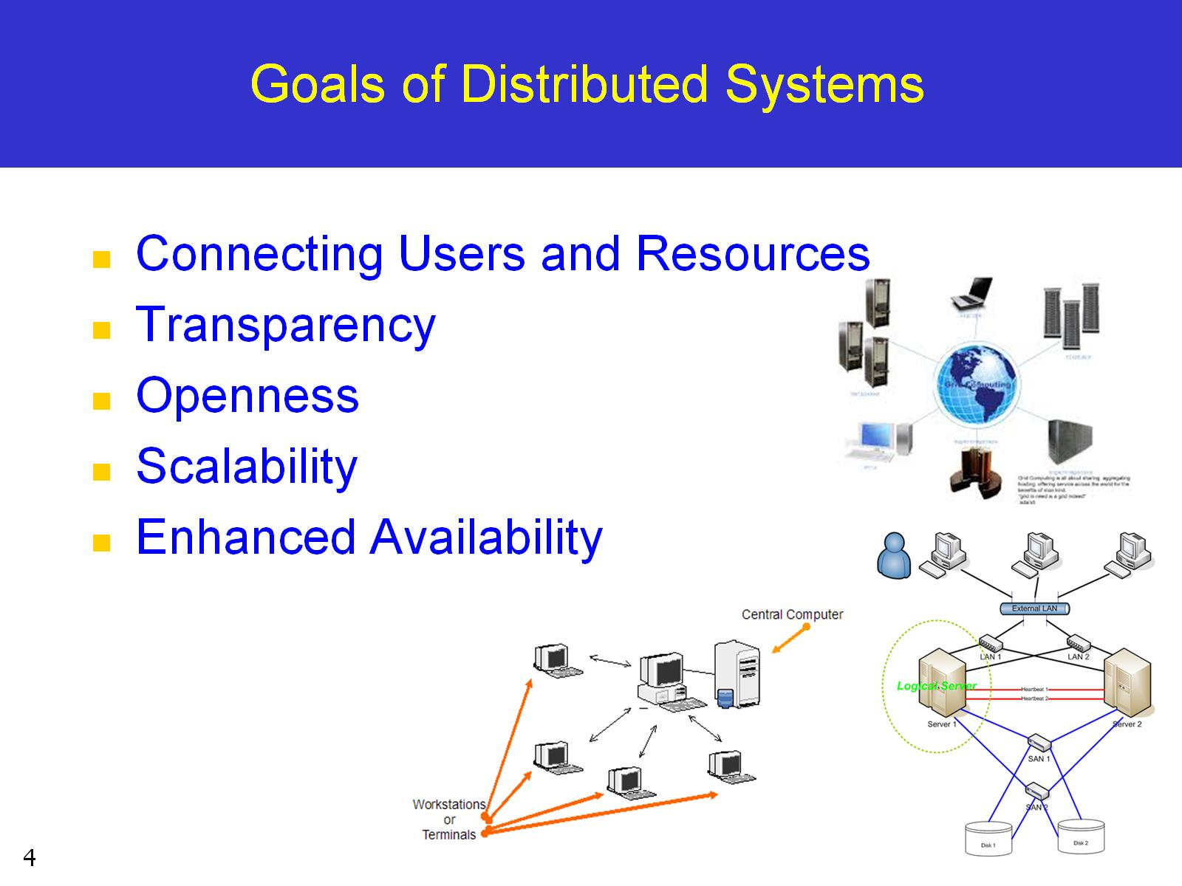
Goals of Distributed Systems

Slide 5
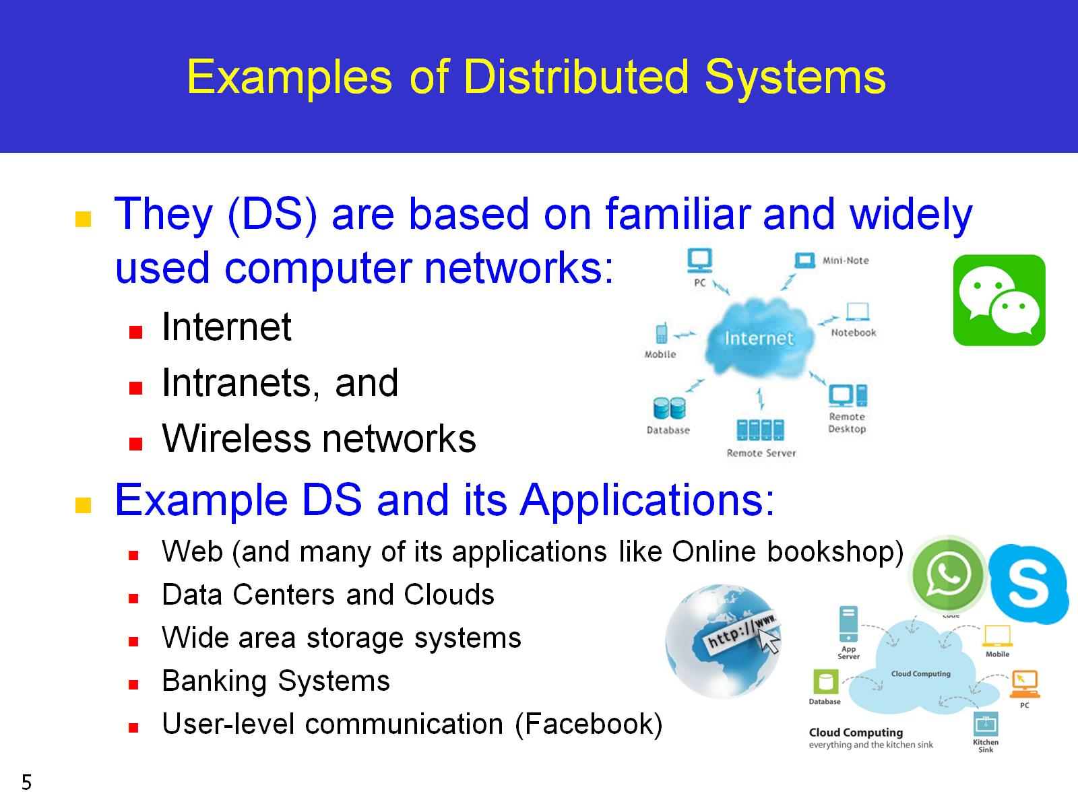
Examples of Distributed Systems

Slide 6
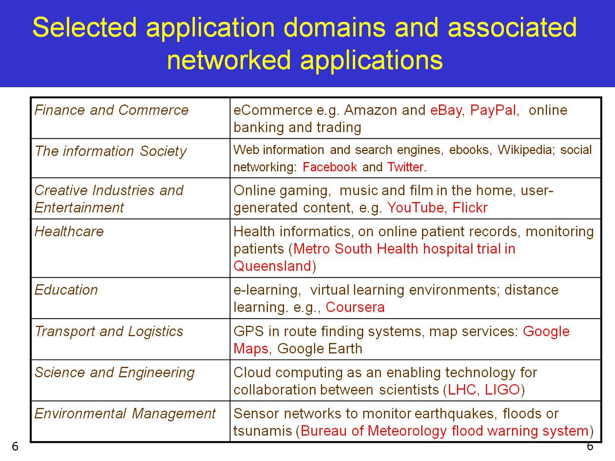
Selected application domains and associated networked applications

Slide 7
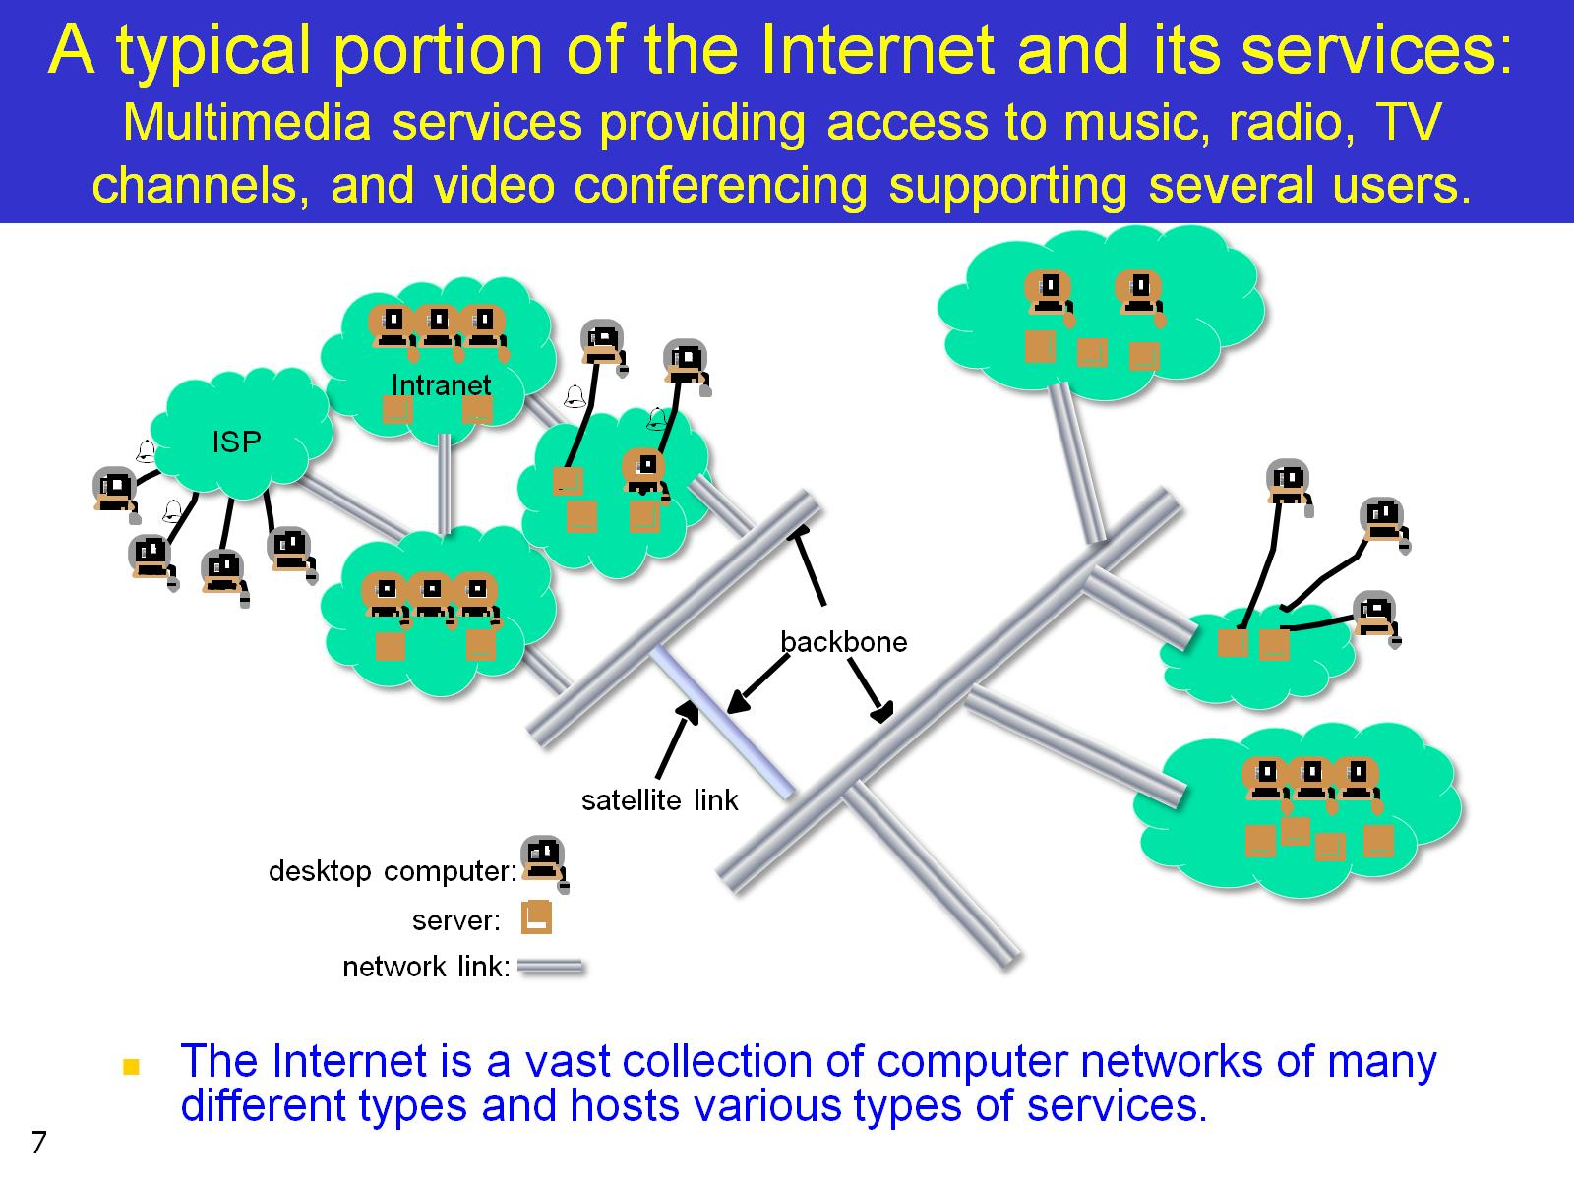
A typical portion of the Internet and its services: Multimedia services providing access to music, radio, TV channels, and video conferencing supporting several users.

Slide 8
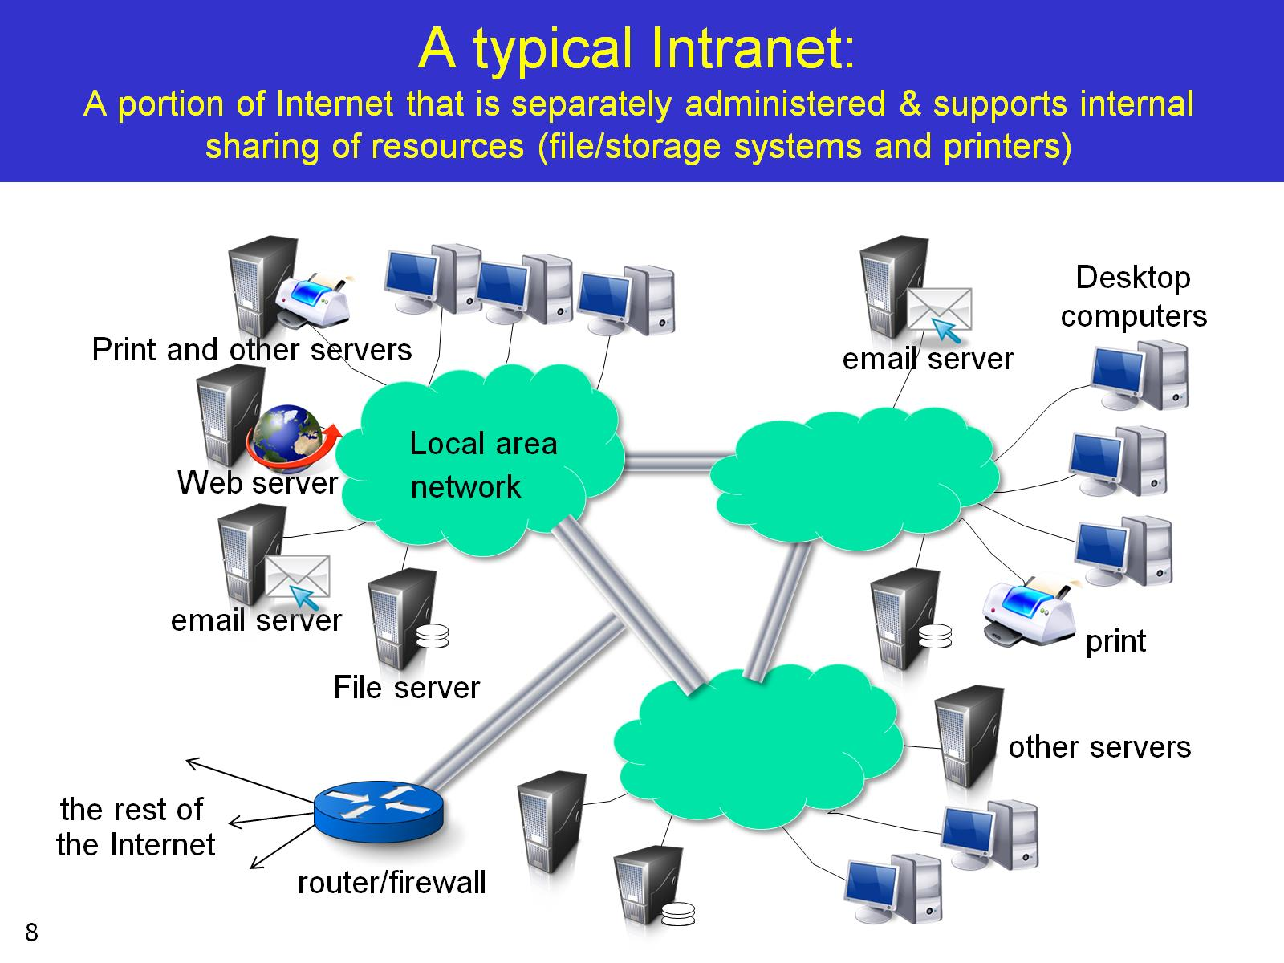
A typical Intranet: A portion of Internet that is separately administered & supports internal sharing of resources (file/storage systems and printers)

Slide 9
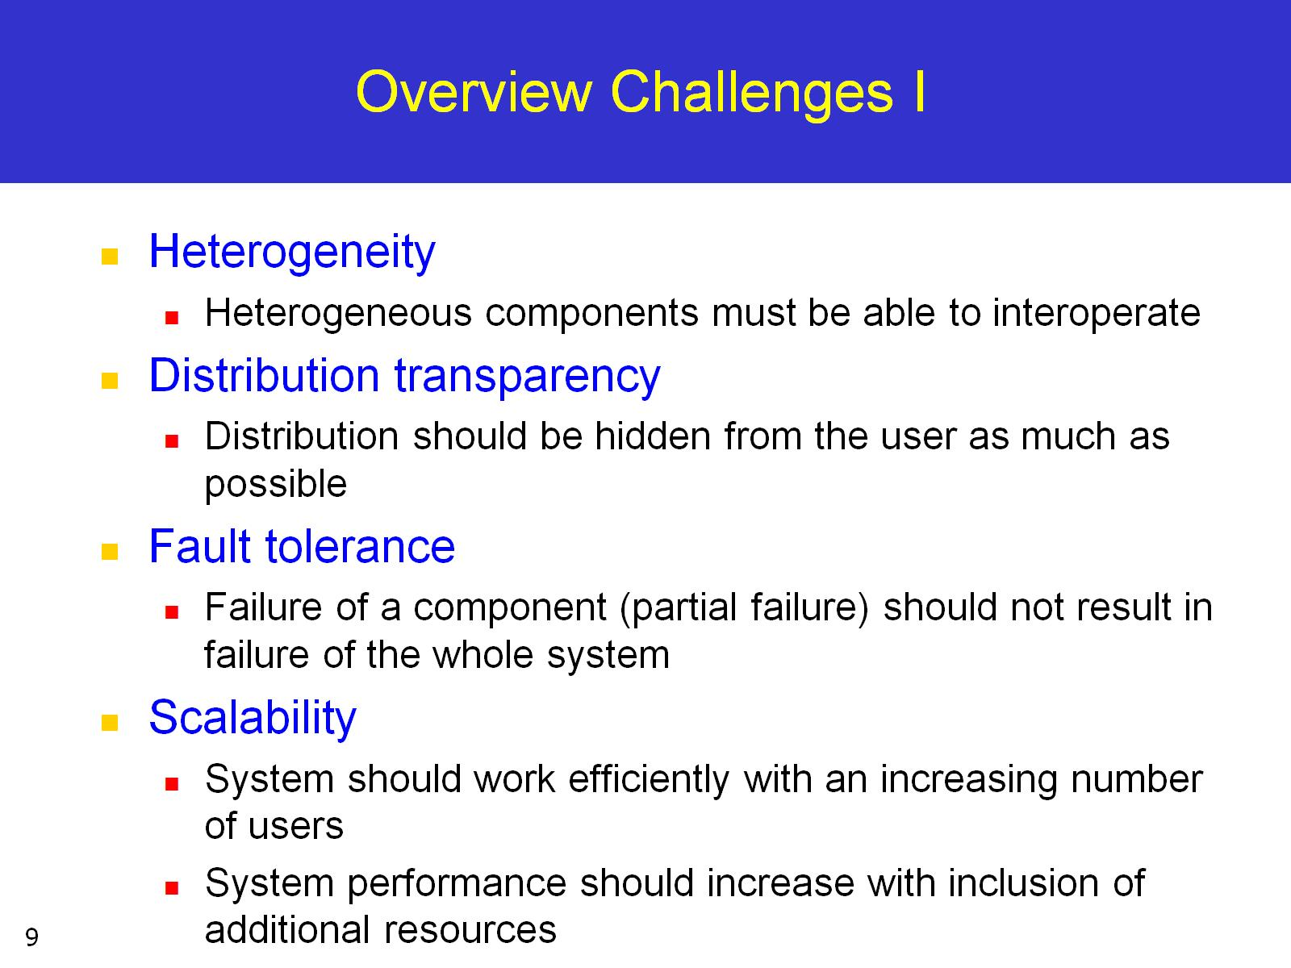
Overview Challenges I

Slide 10
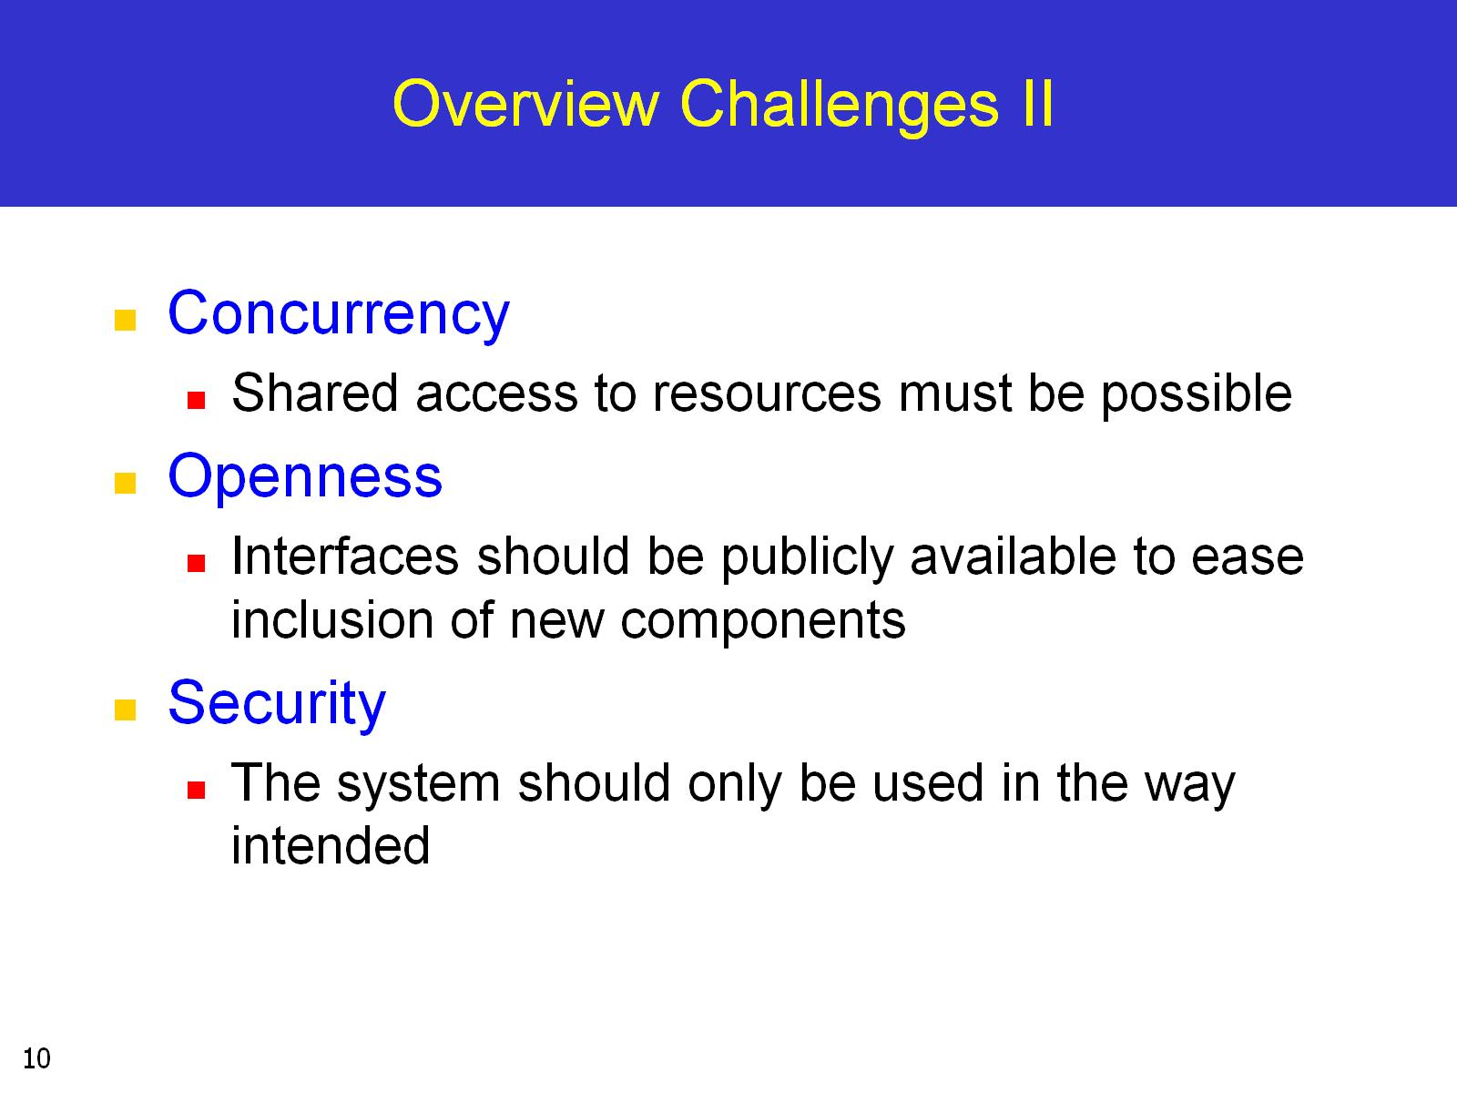
Overview Challenges II

Slide 11
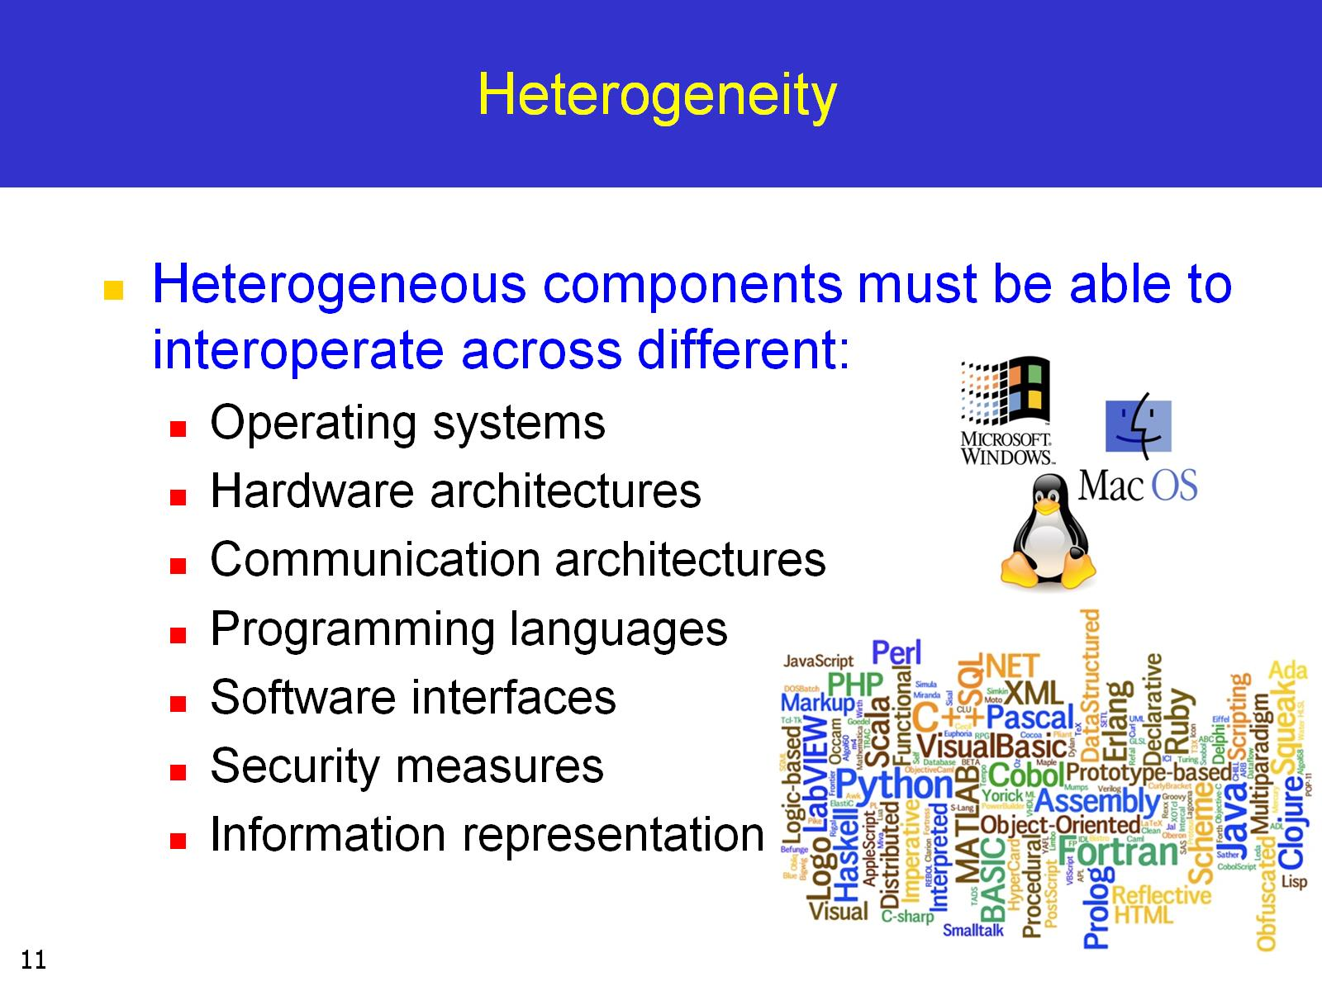
Heterogeneity

Slide 12
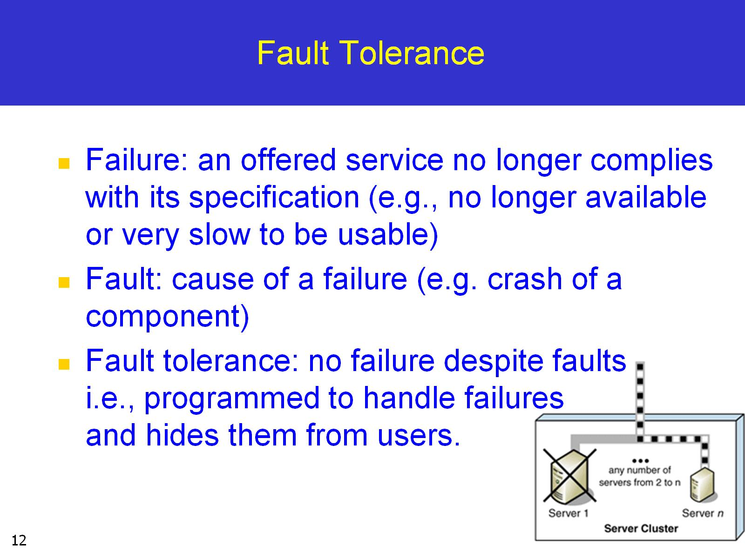
Fault Tolerance

Slide 13
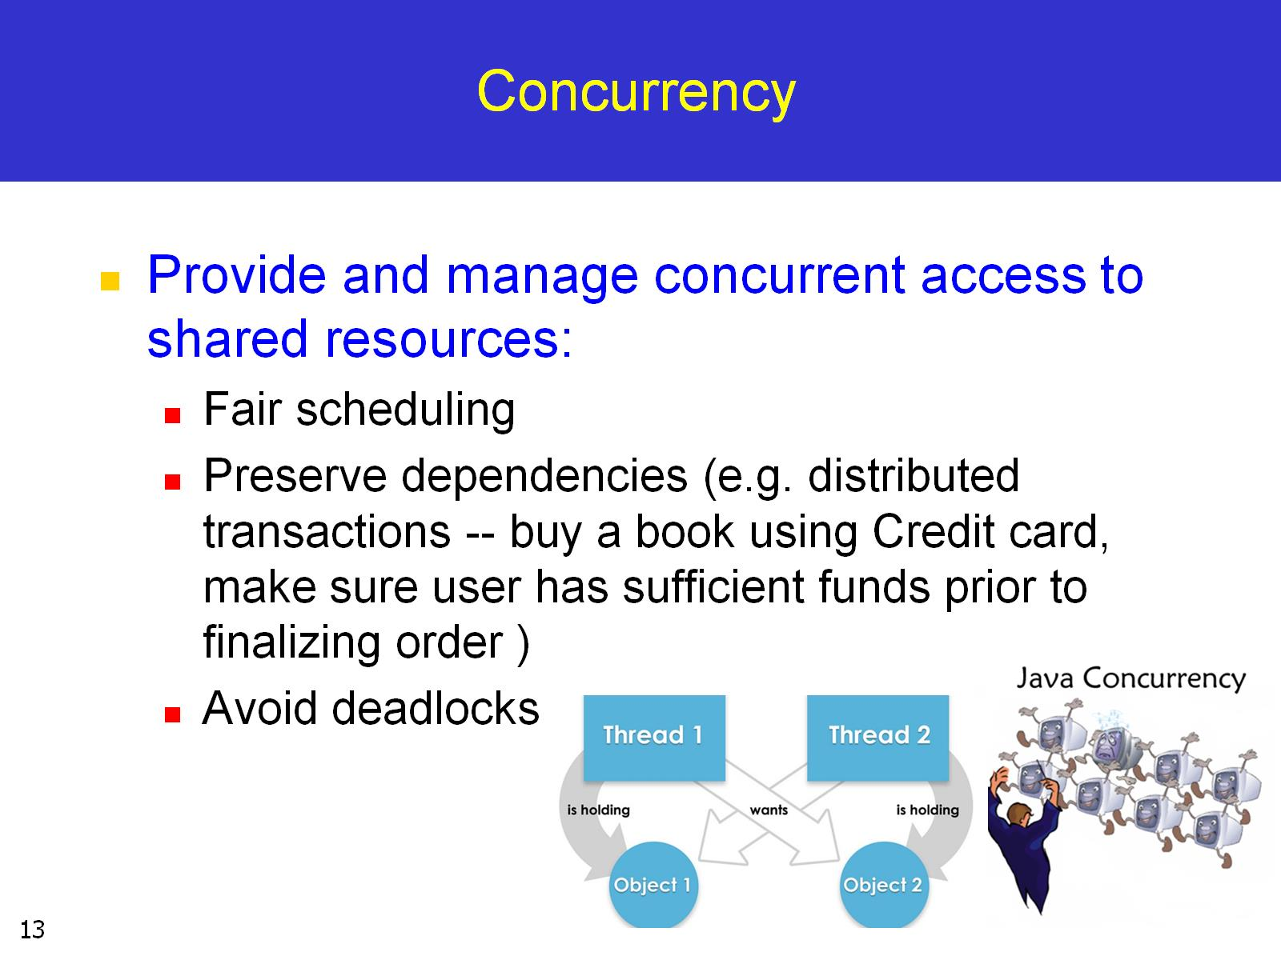
Concurrency

Slide 14
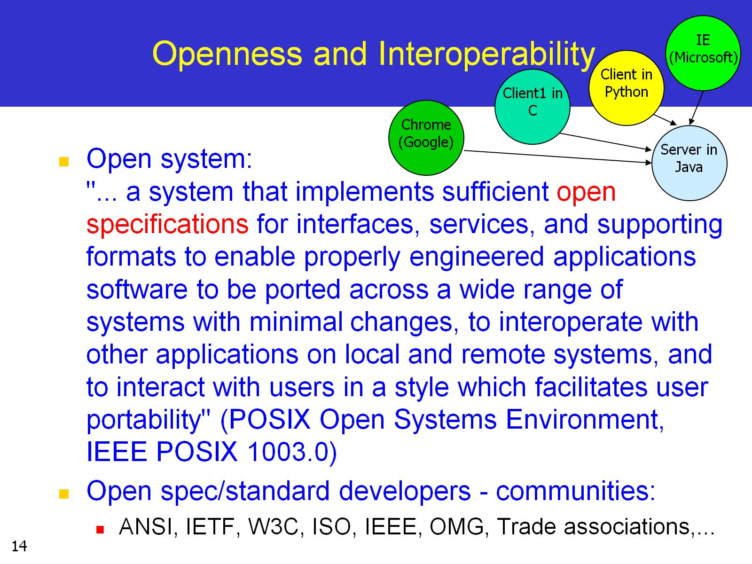
Openness and Interoperability

Slide 15
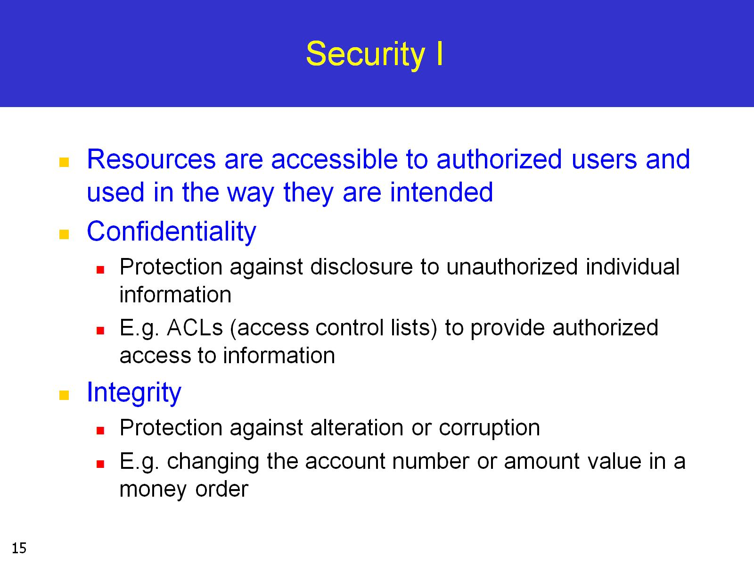
Security I

Slide 16
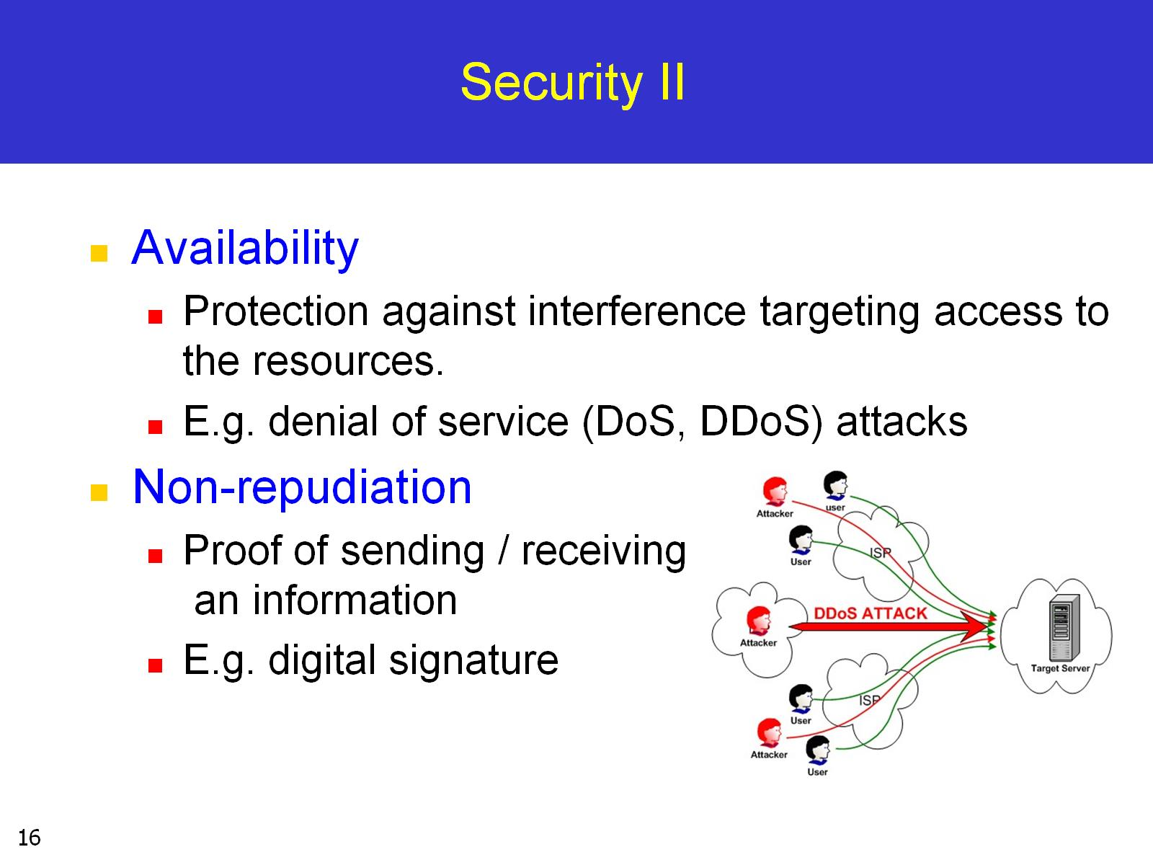
Security II

Slide 17
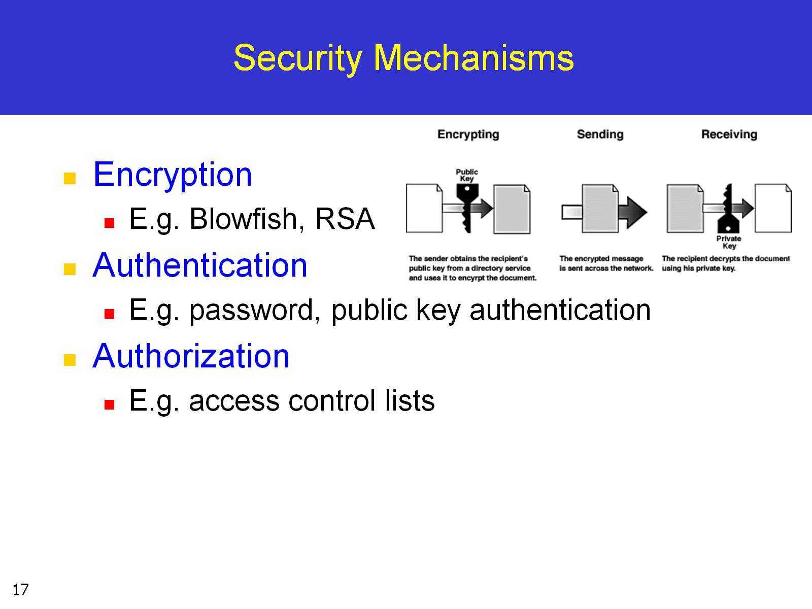
Security Mechanisms

